Slide 1
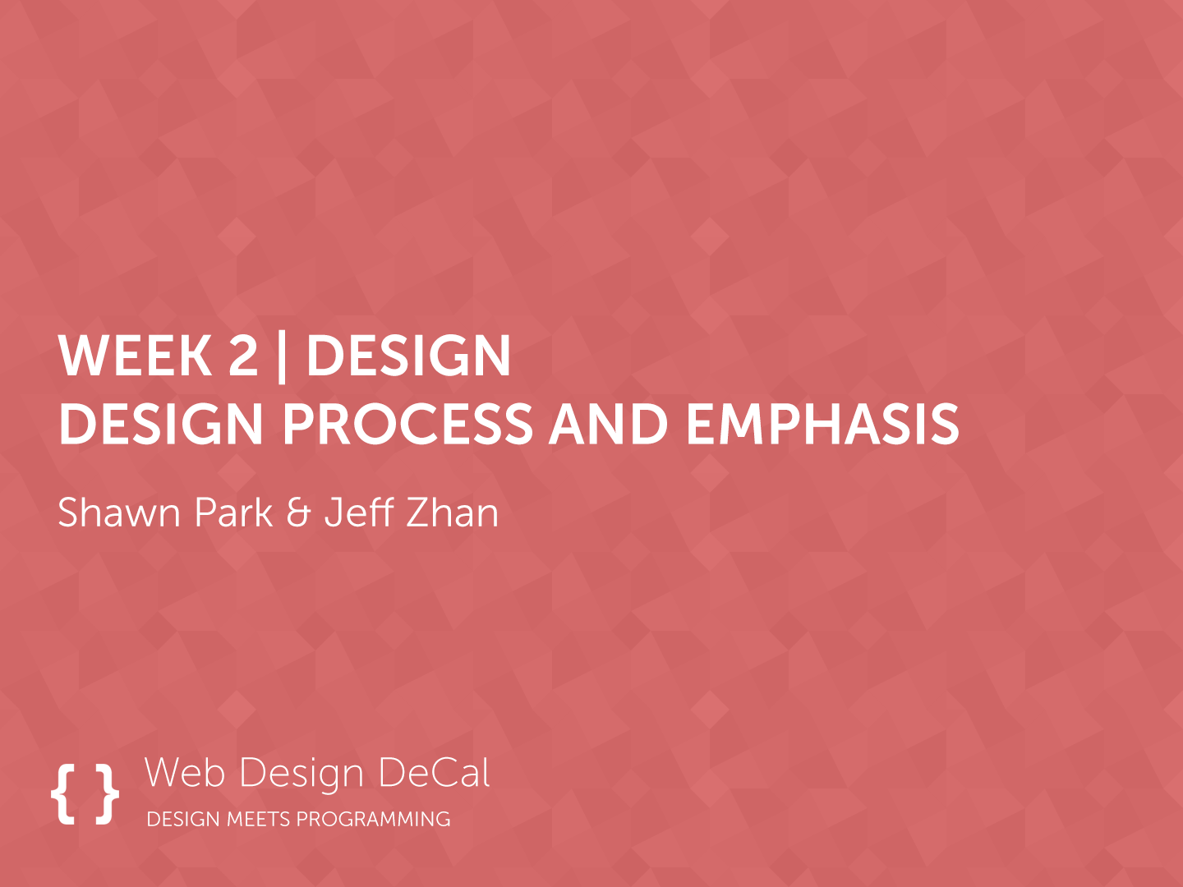

Slide 2

Previous Class
A web site is a collection of web pages
HTML provides the structure of a web page
CSS provides the design of a web page
JS provides the functionality of a web page

Slide 3
Today
A review of web inspector
Fundamental Rule of UI Design Aesthetics: Emphasis
Introduction to Design Cycle

Slide 4
UI Design Workflow
HTML
Code up the structure in a code editor
CSS
Stylize the website using the Web Inspector
JS
Add the missing functionality in the code editor

Slide 5
Demo

Slide 6
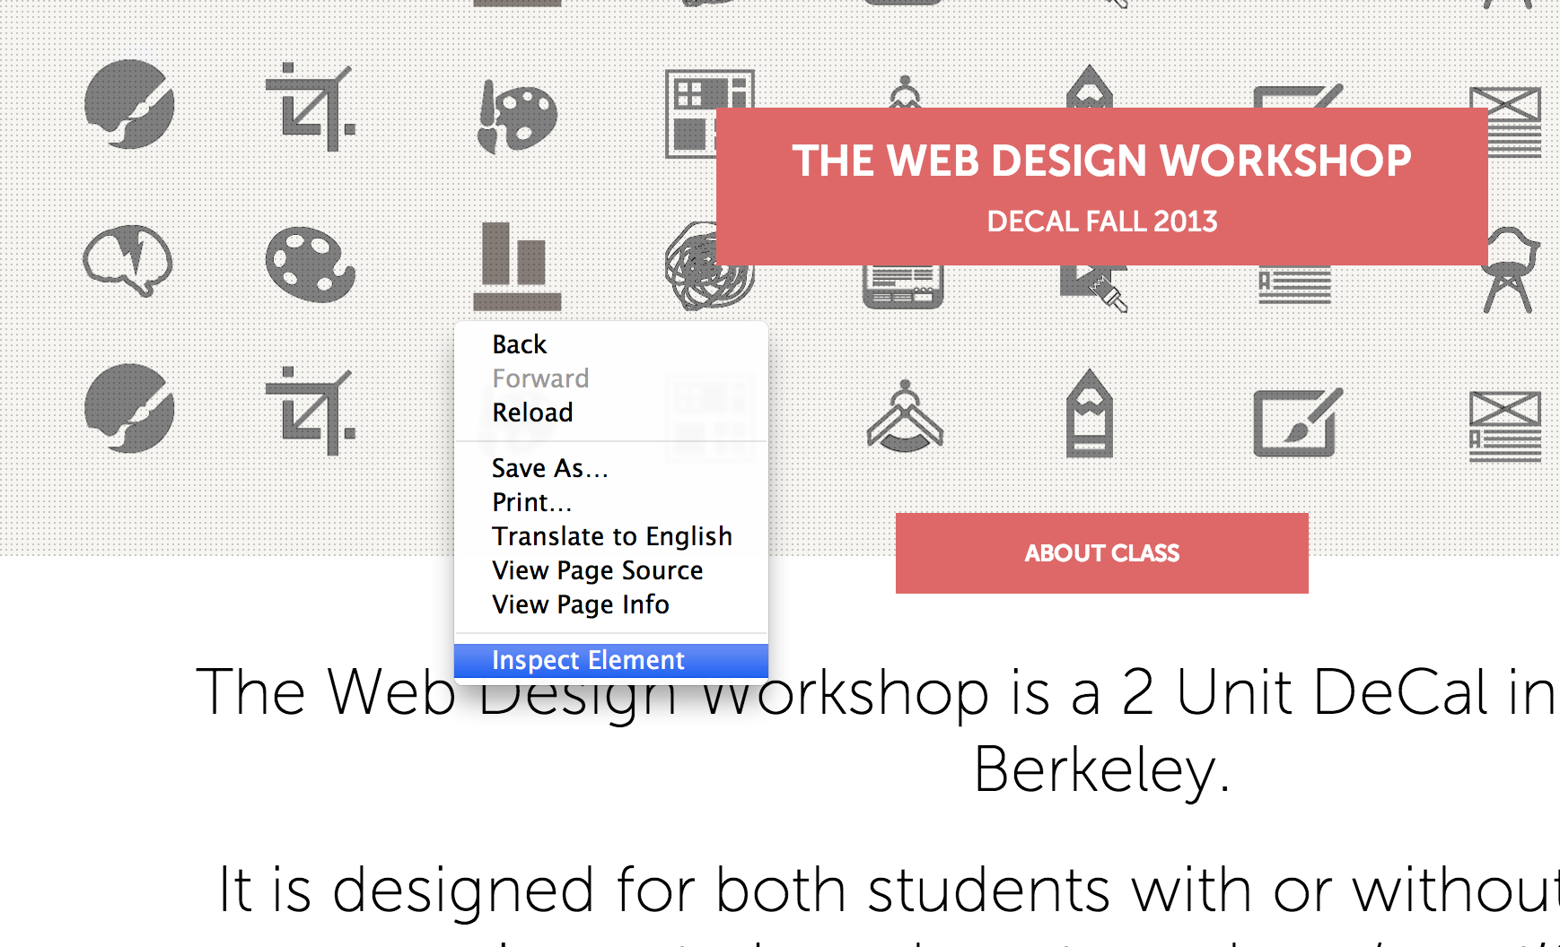
Web Inspector to the rescue!
How to open up Web Inspector

Slide 7
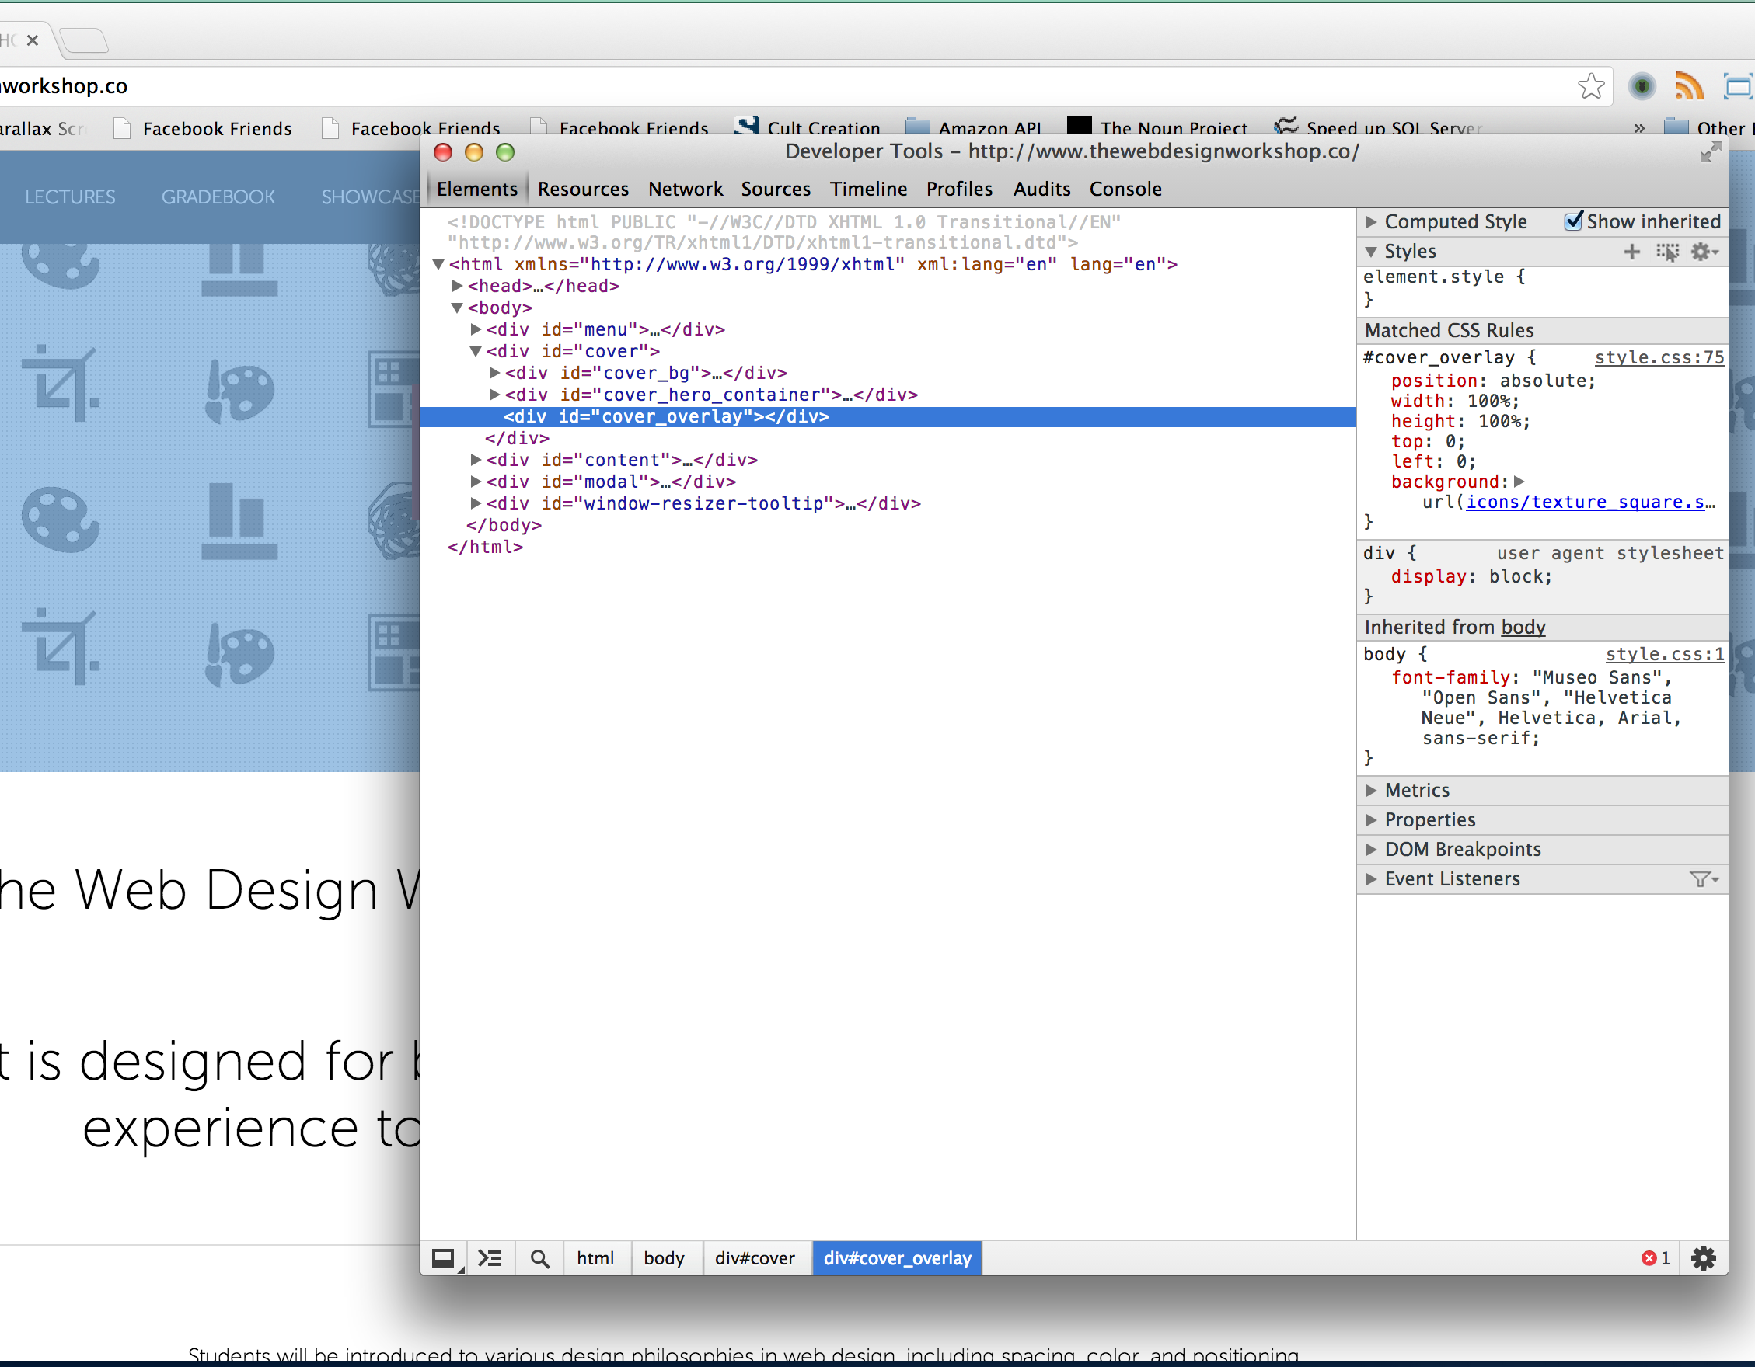
Web Inspector to the rescue!
The selected element is highlighted as Web Inspector opens

Slide 8
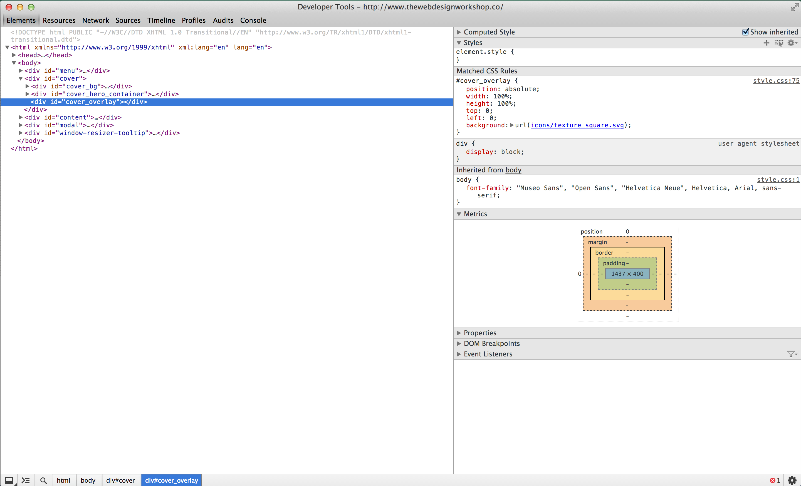
Web Inspector to the rescue!
CSS Editor
Selected Element
Metrics
Elements Tab of the Web Inspector A place for editing web site design on the fly
Notes:
Edit website designs
Peek at other people’s designs
Majority of time here

Slide 9
Web Inspector Workflow
Open up the Web inspector using “Inspect Element”
Find the element you want to edit, and enter new CSS rules
Fiddle around until it looks good
Take the final code to the Code Editor

Slide 10
A Few Caveats about Web Inspector
Changes you made in web inspector are NOT saved automatically
Must make sure changes are saved by:
Going to Resources Tab -> Find your CSS file and copy paste all the code to your CSS file (Modification)
Going to Resources Tab -> Find inspector-style.css and copy paste all the code to your CSS file (Addition)

Slide 11
Introduction to Design Theory
A well-designed user interface
Emphasizes core features through UI Aesthetics
Makes an application easy to use through good User Experience
We will spend the first half of the semester on UI Aesthetics
UI Aesthetics is NOT making things pretty
UI Aesthetics is emphasizing core features
Establishing a priority in an application

Slide 12
Emphasis
Emphasis is a hallmark of great UI Design
Well-designed websites emphasize core features
…Using Skeumorphism (A Paper on top of a desk)
…Using Flat UI
Different shade of box
A drop-shadow on a box
Different Font size
Animations

Slide 13
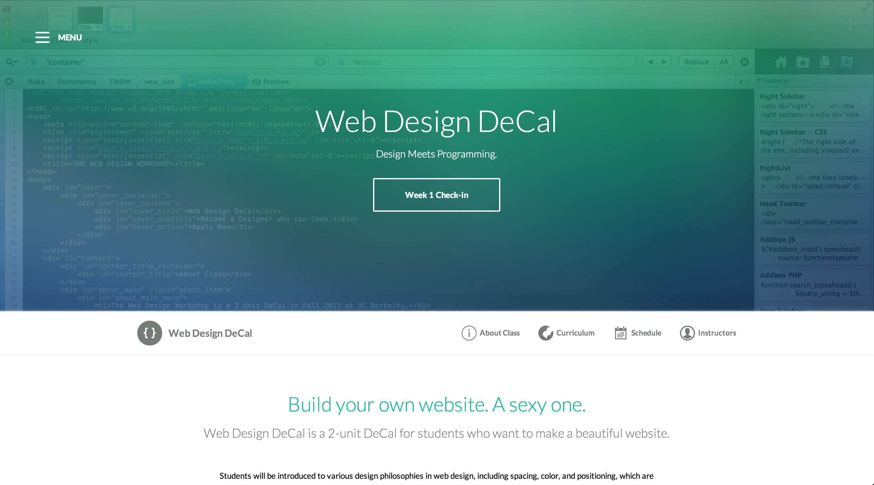
EX: Use of Emphasis in Web Design DeCal Website
Notes:
JS-equivalent of the elements tab
Try out a code before actually going into the code editor

Slide 14
Emphasis
GOAL:
Bring order to complexity by emphasizing important elements
Notes:
A goal of a user interface is not to just please the eye, but to improve the overall usability of a product
Art can be used to improve the efficiency of a product (Art ⬄ Efficiency)

Slide 15
This Class
Good UI Design = Emphasis
Goal of this class is to give you an overview of all the tools you need for bringing emphasis/order to your web page

Slide 16
Four pillars for Emphasis
Emphasis
Spacing
Positioning
Typography
Color

Slide 17
Design Cycle
Ideation
Prototype
Evaluation

Slide 18
Step 1: Ideation
Identify the Need (What are you making the website for?)
Identify the Hierarchy (What are the core features/sections for the website?)
Identify the Execution (What is the appropriate design for the need and the hierarchy?)

Slide 19
Emphasis
Case Study: Google
What is the purpose of Google?
Notes:
A goal of a user interface is not to just please the eye, but to improve the overall usability of a product
Art can be used to improve the efficiency of a product (Art ⬄ Efficiency)

Slide 20
Emphasis
Case Study: Google
What is the most important feature of Google?
Notes:
A goal of a user interface is not to just please the eye, but to improve the overall usability of a product
Art can be used to improve the efficiency of a product (Art ⬄ Efficiency)

Slide 21
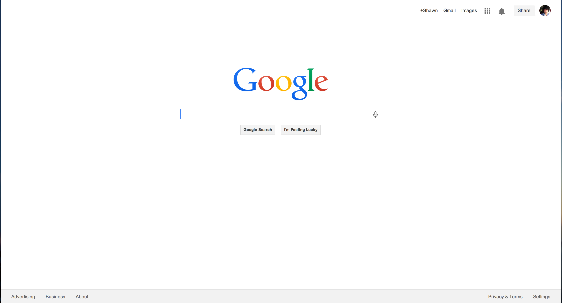
Google’s use of Emphasis
Notes:
JS-equivalent of the elements tab
Try out a code before actually going into the code editor

Slide 22
Emphasis
Case Study: Craigslist
What is the purpose of Craigslist?
Notes:
A goal of a user interface is not to just please the eye, but to improve the overall usability of a product
Art can be used to improve the efficiency of a product (Art ⬄ Efficiency)

Slide 23
Emphasis
Case Study: Craigslist
What is the most important feature of Craigslist?
Notes:
A goal of a user interface is not to just please the eye, but to improve the overall usability of a product
Art can be used to improve the efficiency of a product (Art ⬄ Efficiency)

Slide 24
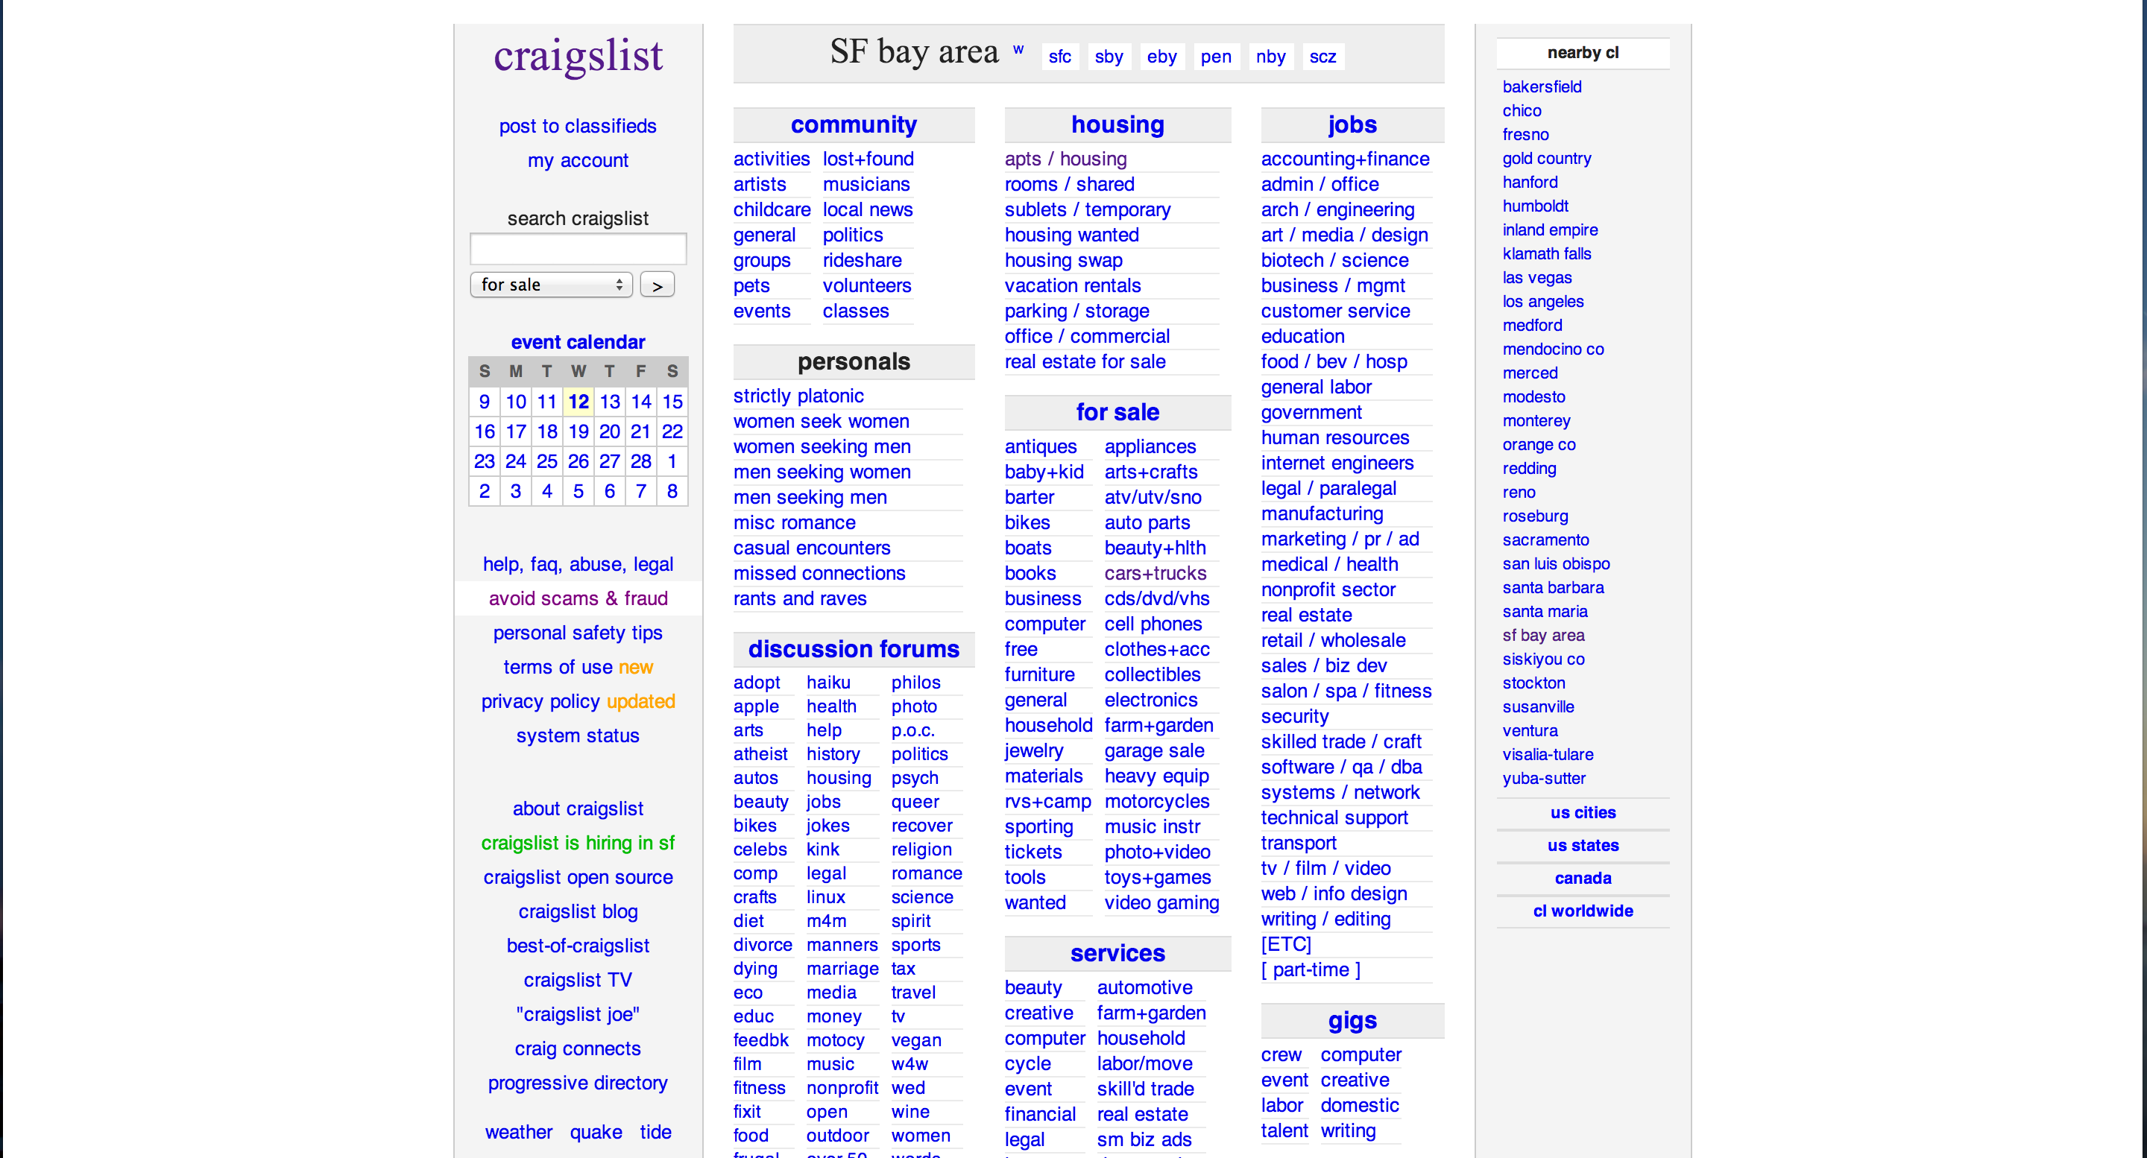
Craigslist’s (mis)use of Emphasis
Notes:
JS-equivalent of the elements tab
Try out a code before actually going into the code editor

Slide 25
Emphasis
Case Study: Craigslist
What are other great e-commerce websites?
Notes:
A goal of a user interface is not to just please the eye, but to improve the overall usability of a product
Art can be used to improve the efficiency of a product (Art ⬄ Efficiency)

Slide 26
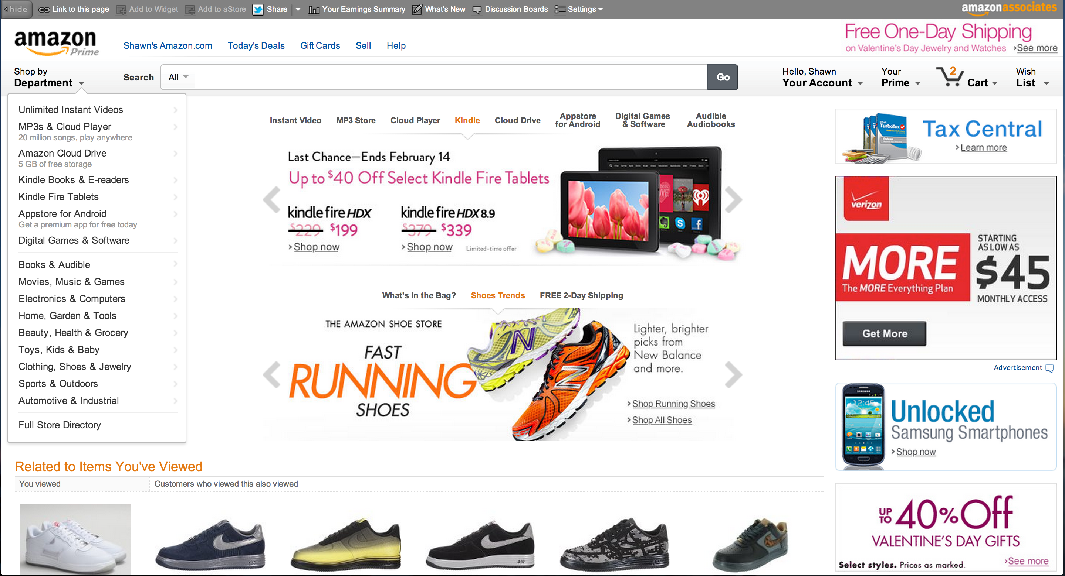
Amazon
Notes:
JS-equivalent of the elements tab
Try out a code before actually going into the code editor

Slide 27
Emphasis
Case Study: Craigslist
What are other websites that showcase imagery?
Notes:
A goal of a user interface is not to just please the eye, but to improve the overall usability of a product
Art can be used to improve the efficiency of a product (Art ⬄ Efficiency)

Slide 28
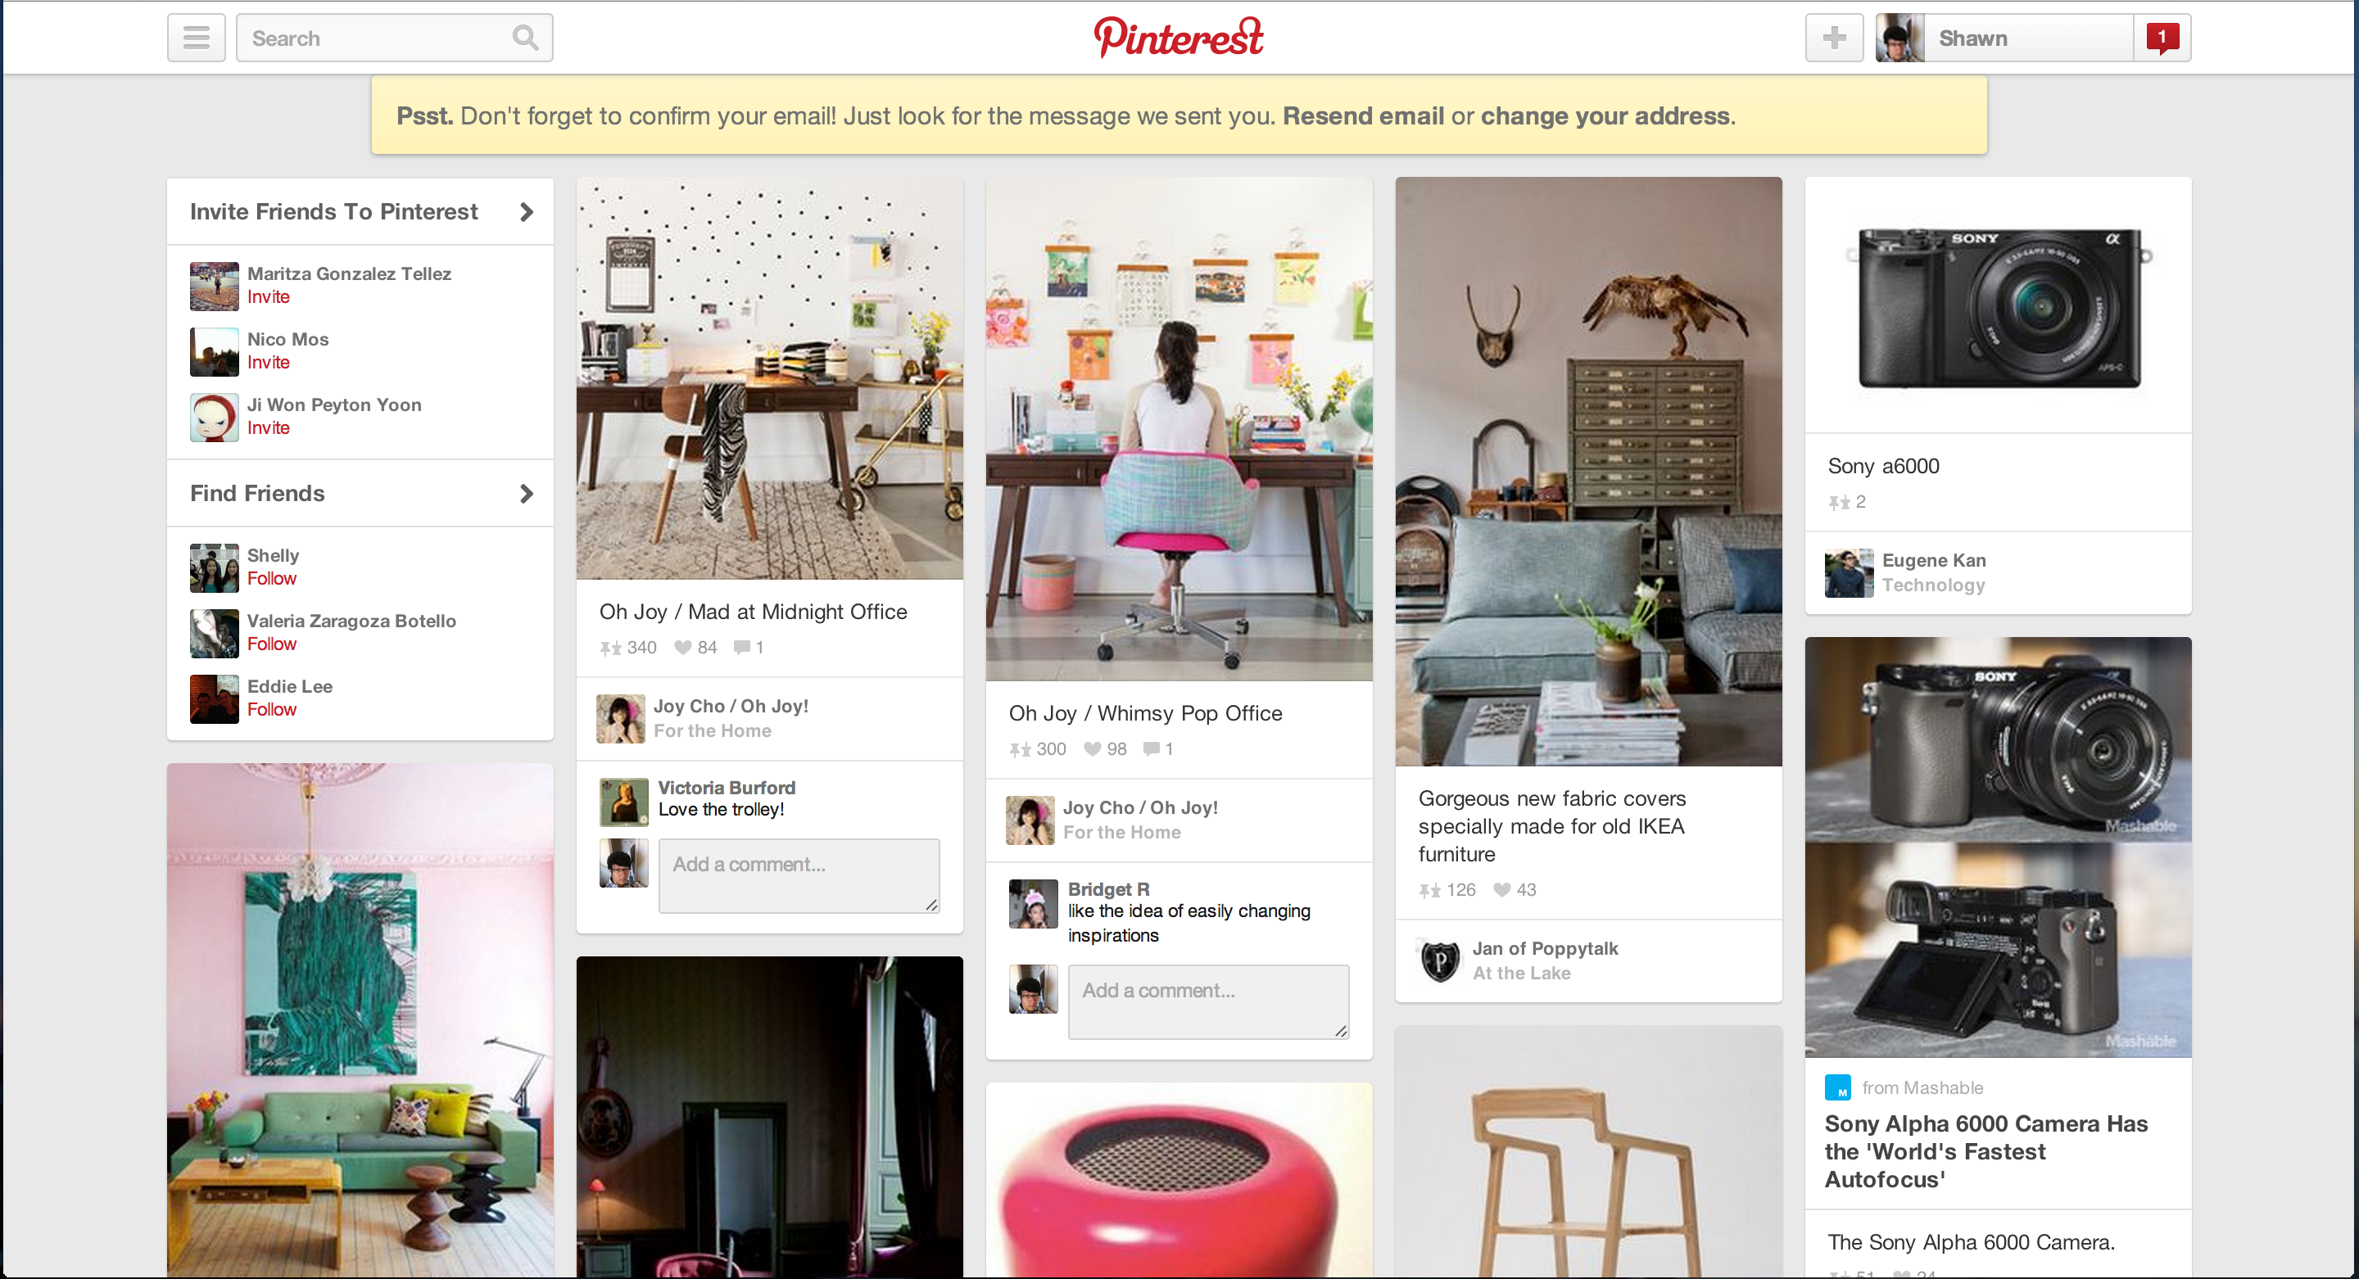
Pinterest
Notes:
JS-equivalent of the elements tab
Try out a code before actually going into the code editor

Slide 29
Emphasis
Case Study: Craigslist
What are other good websites to get inspiration from?
Notes:
A goal of a user interface is not to just please the eye, but to improve the overall usability of a product
Art can be used to improve the efficiency of a product (Art ⬄ Efficiency)

Slide 30
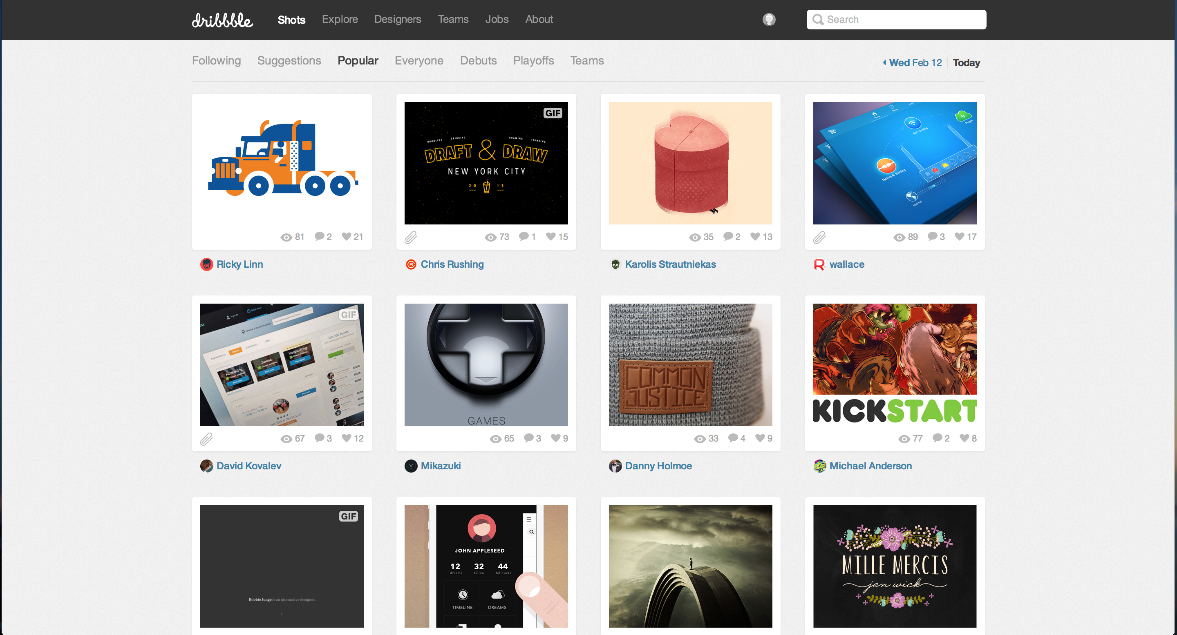
Dribbble
Notes:
JS-equivalent of the elements tab
Try out a code before actually going into the code editor

Slide 31
Step 2: Prototype
Low-fi Prototype: Sketches
Will save you tons of time
Easier to iterate
Allow you to be more creative
Hi-fi Prototype: HTML5 / CSS
Convert the sketches to code
Follow the front-end design workflow:
Structure HTML5 => Style CSS => Function JS
Think about: 1. Spacing 2. Positioning 3. Typography & Images 4. Color

Slide 32
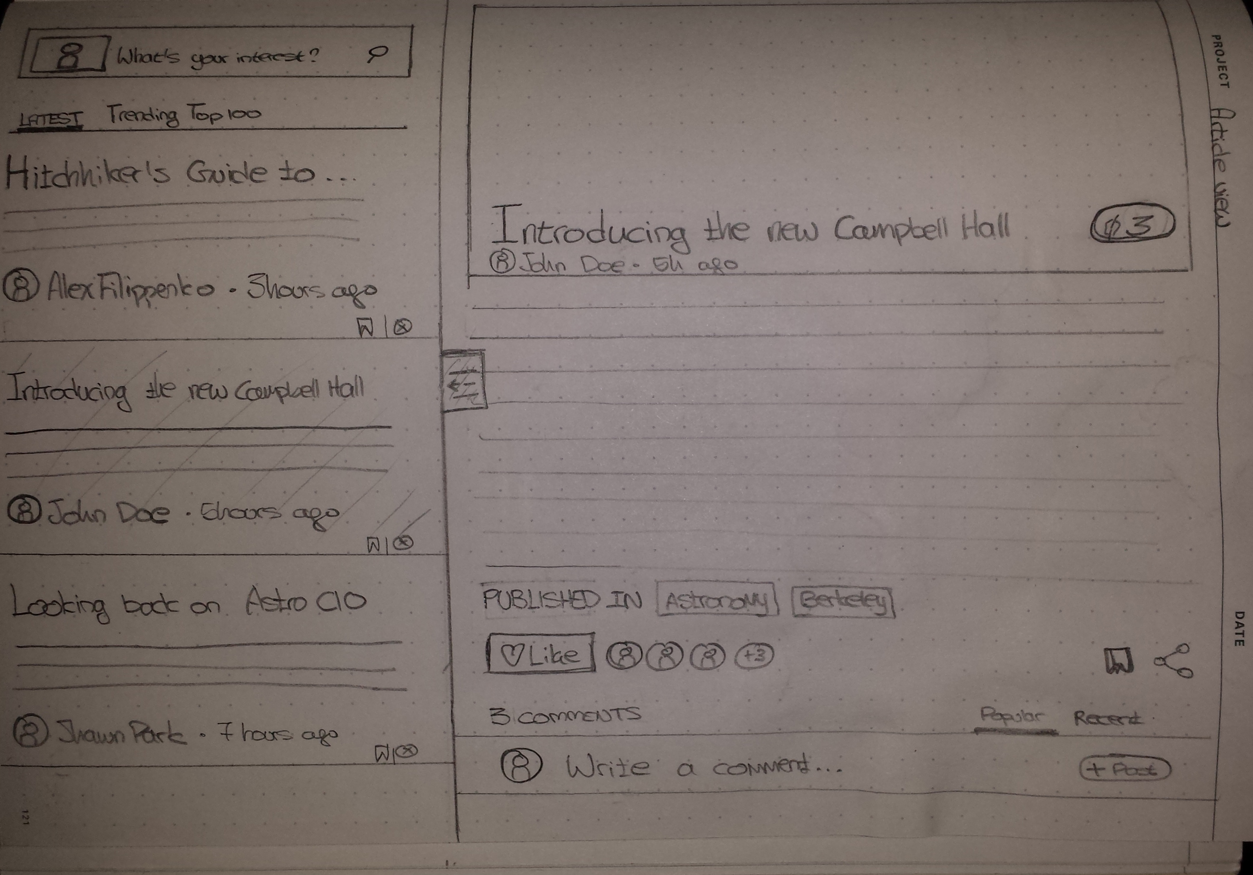
Sketches: Pencil, Eraser, and (maybe) Ruler
Notes:
JS-equivalent of the elements tab
Try out a code before actually going into the code editor

Slide 33
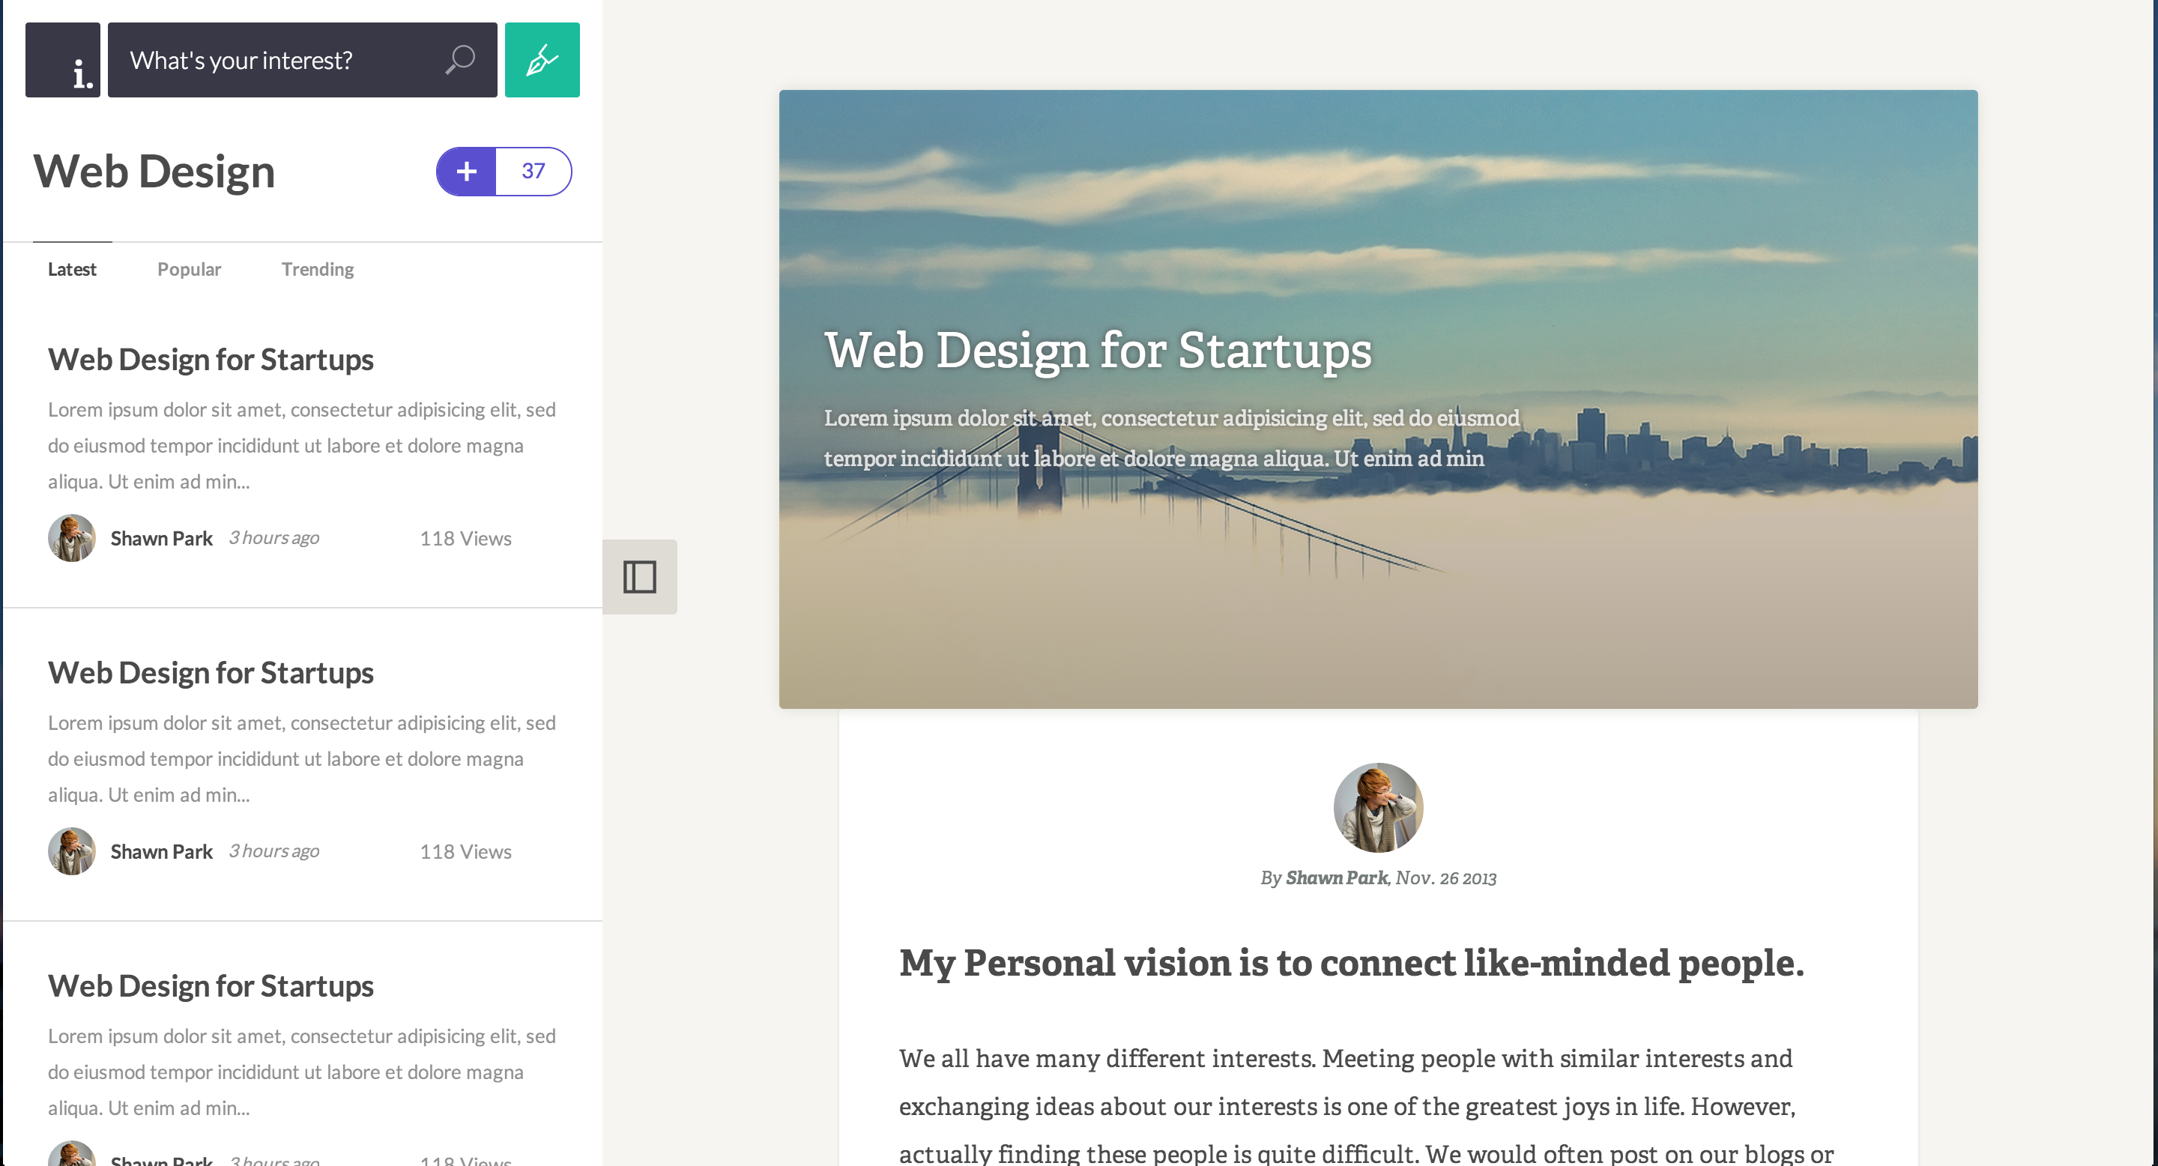
Code: HTML5, CSS, and JS
Notes:
JS-equivalent of the elements tab
Try out a code before actually going into the code editor

Slide 34
Step 3: Evaluation
Receive feedback from the client and/or user
A designer often falls into a tunnel vision that his/her design looks good even though the user doesn’t think so
Note areas to improve and iterate
Much better to create a MVP and iterate than to create a polished product from the start
Why? Design is often uncertain (Especially for application-websites)

Slide 35
Group Project
Work in a group of 3 ~ 5 people
Some portion of design section hands-on will be spent on group project
Auditors: can participate in hands-on session, but cannot join an official project team
You will be working on a redesign of an existing website that is useful, but in need of an aesthetic facelift.

Slide 36
Group Project
Reddit Redesign
Notes:
A goal of a user interface is not to just please the eye, but to improve the overall usability of a product
Art can be used to improve the efficiency of a product (Art ⬄ Efficiency)

Slide 37
Review
Web Inspector: Use to preview stylesheets in browser
Fundamental Rule of UI Design Aesthetics: Emphasis
Design Process: 1. Ideation 2. Prototype 3. Evaluation
Homework 2 available on the website later tonight (a bit long)

Slide 38
Takeaway of the day
“The purpose of design is to bring order to complexity”
Notes:
A goal of a user interface is not to just please the eye, but to improve the overall usability of a product
Art can be used to improve the efficiency of a product (Art ⬄ Efficiency)

